Slide 1






POP ART

Slide 2


LOOK WHAT I’VE MADE
Notes:
What is this in the style of? Pop art. How did I achieve this? What skills did I use?

Slide 3





TAKE A SELFIE
Notes:
Model slides 3 and 4 and then allow the students time to practise those skills.
Discuss camera positioning or working in pairs to get a better quality photo

Slide 4
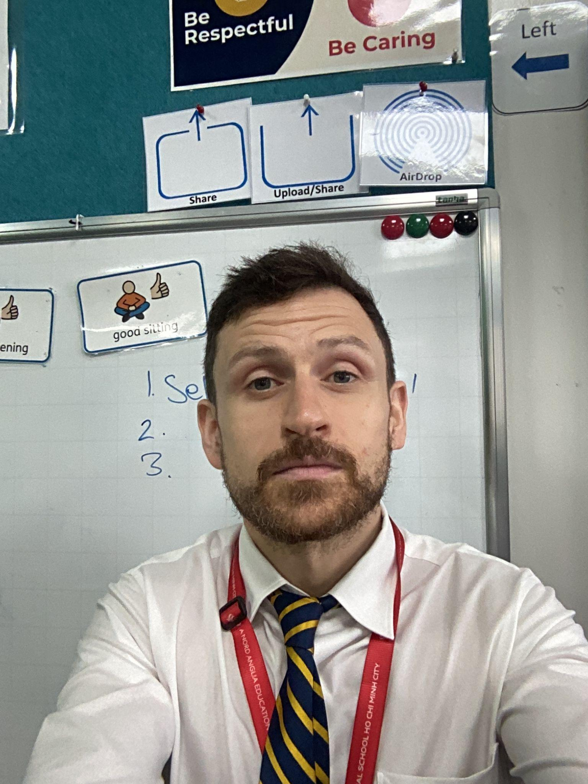
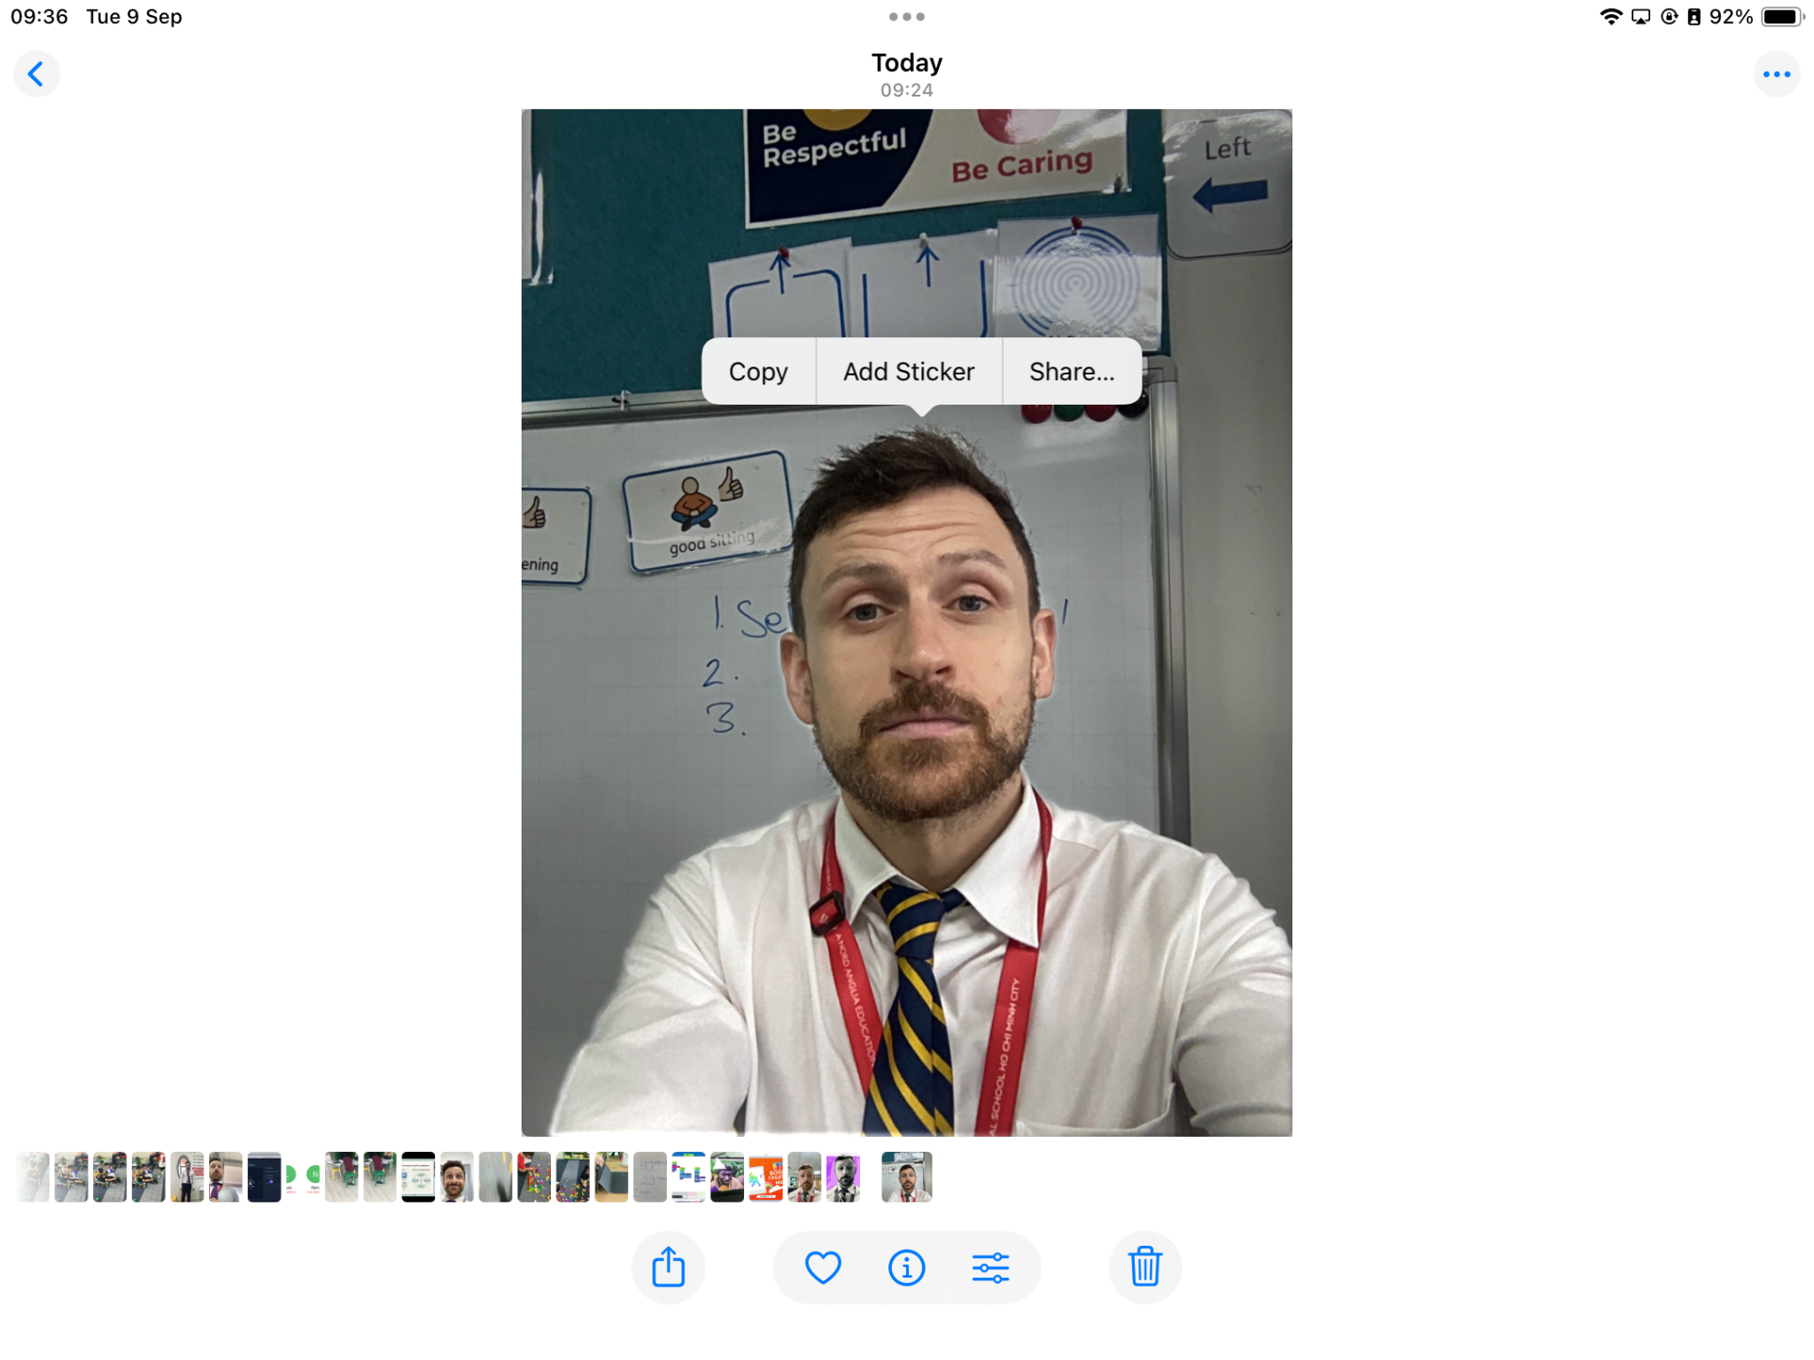
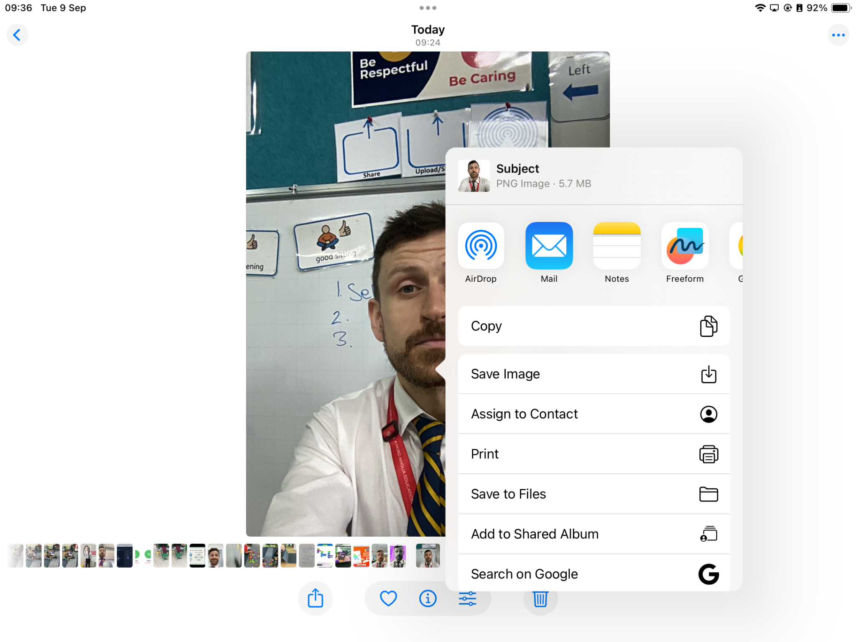

Slide 5
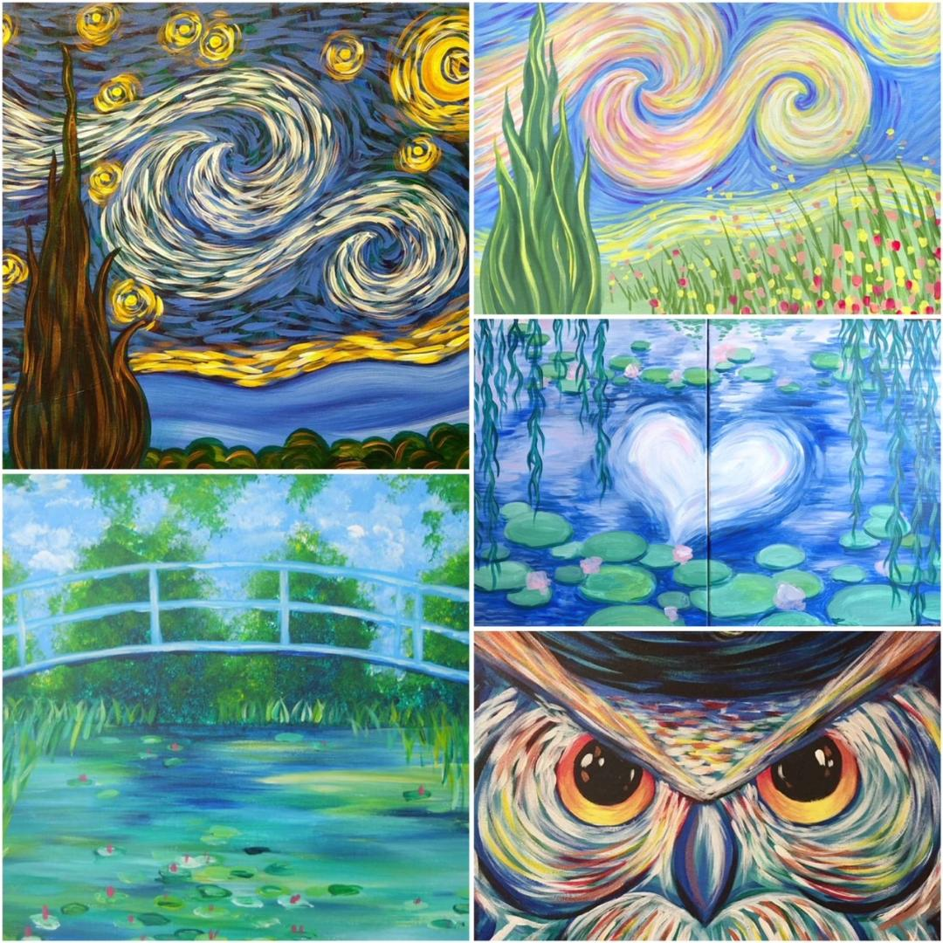

Slide 6

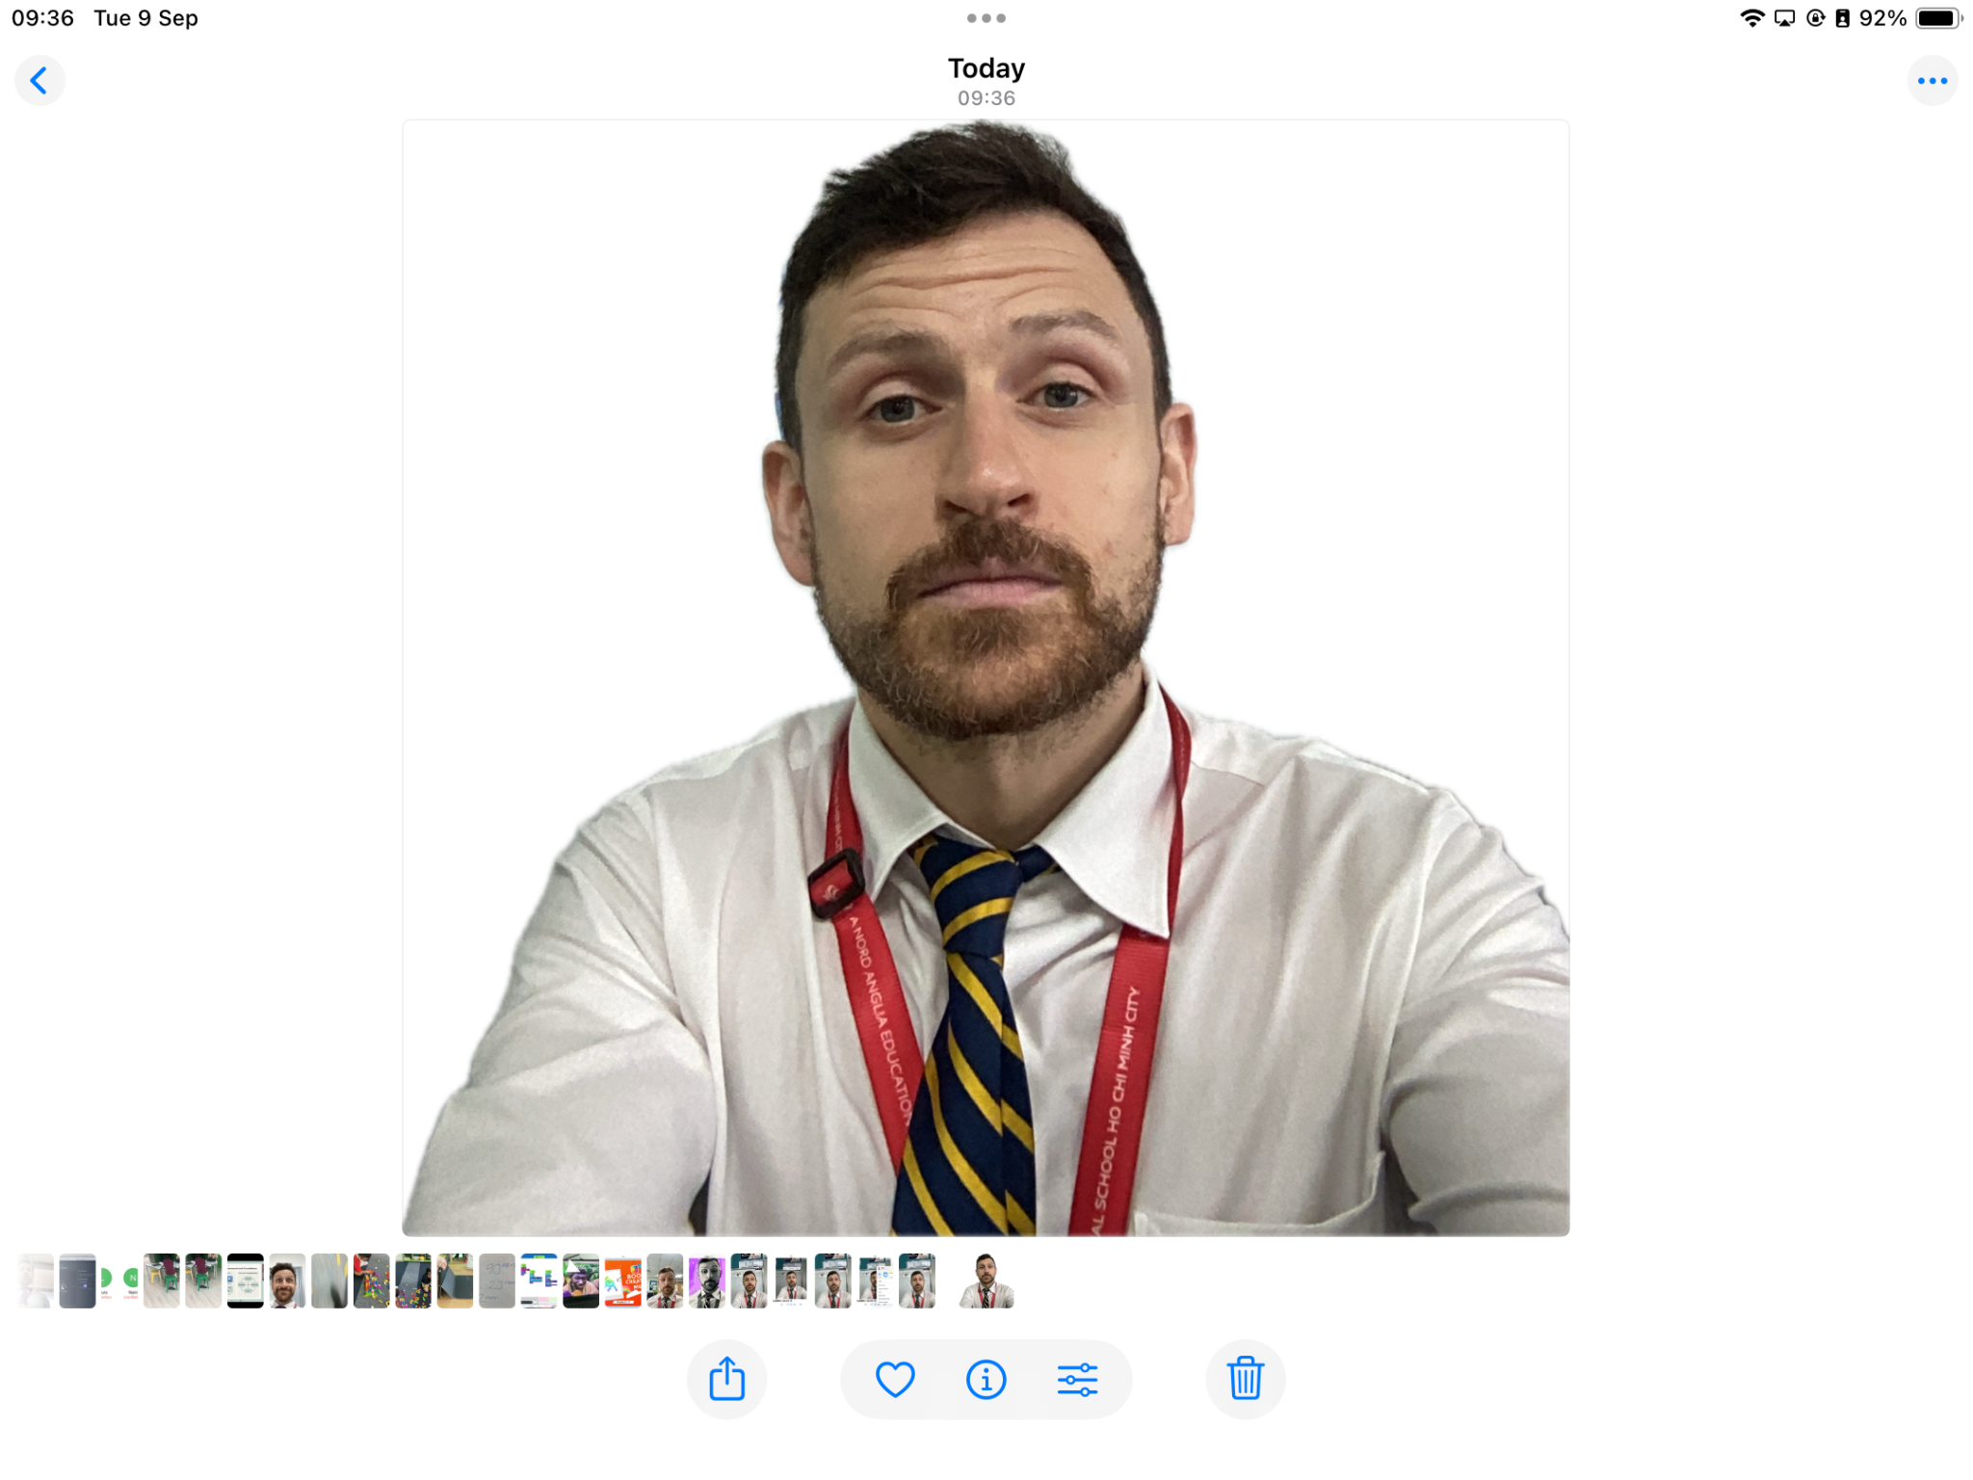
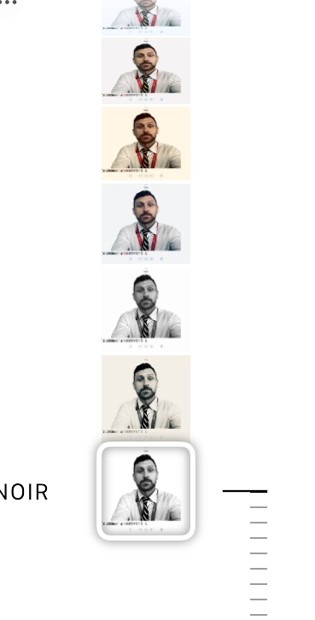
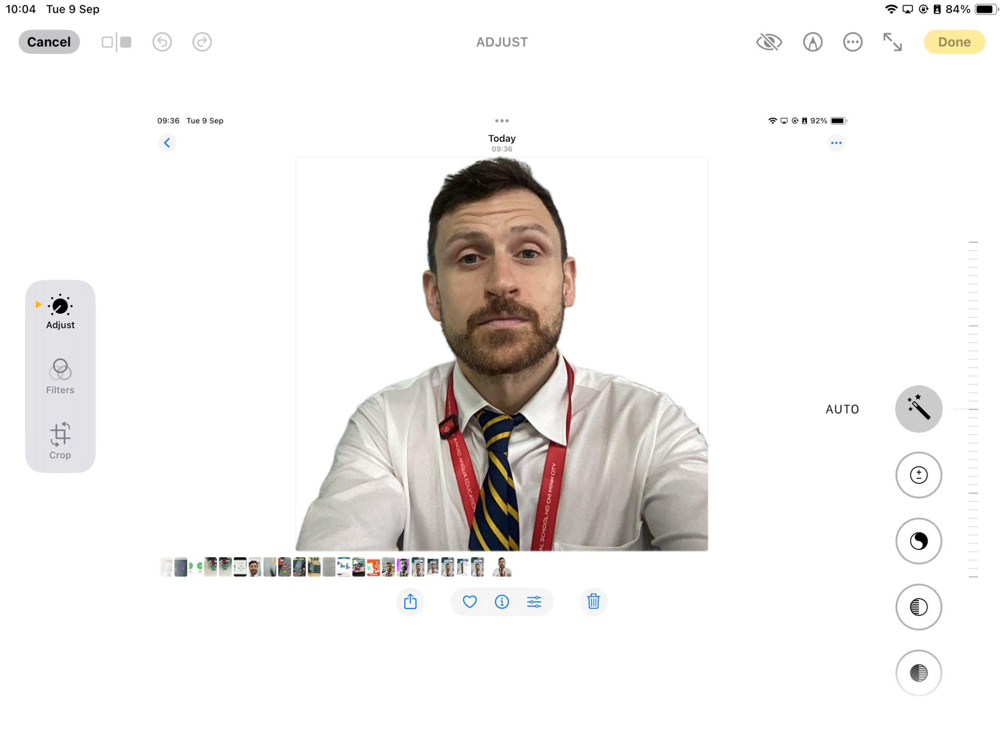
4
2
3
1

Slide 7
Notes:
Model slides 3 and 4 and then allow the students time to practise those skills.
Discuss camera positioning or working in pairs to get a better quality photo

Slide 8

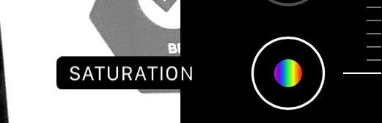

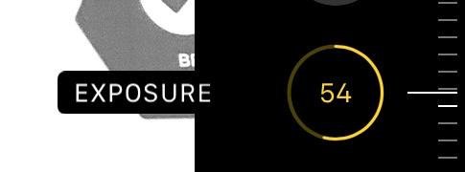
EDIT THE PHOTO
Saturation -100
Contrast 100
Exposure 75

Slide 9


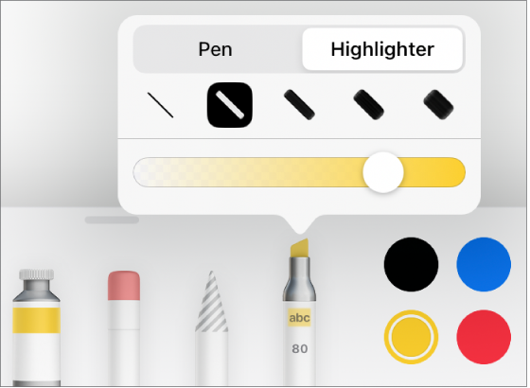
MARK UP PHOTO
Use highlighter to draw outline and shade background in
Notes:
Explain what opacity is and how it can be manipulated. Mention brush strokes to generate texture.

Slide 10
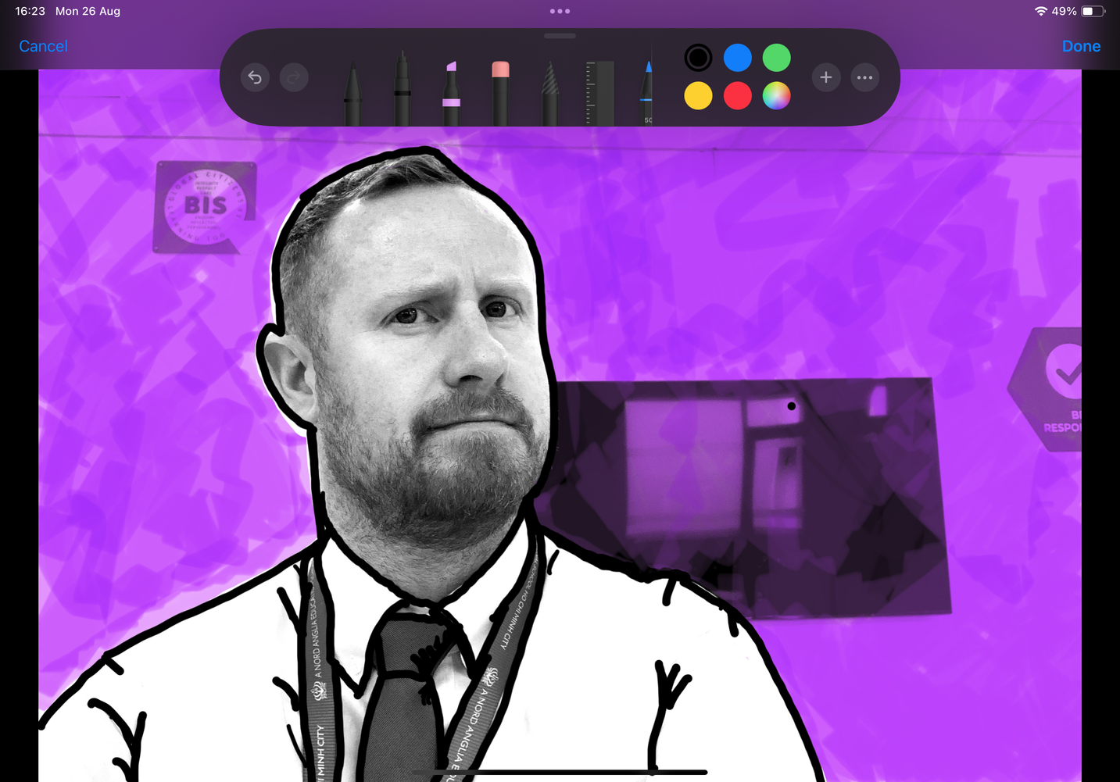
TRACE DETAILS
Use black pen to trace details.
Zoom in!

Slide 11
ADD DRAWING
Draw speech bubbles, sketches or doodles
Notes:
Keep in photo editor or open in keynote to add icons and animations

Slide 12
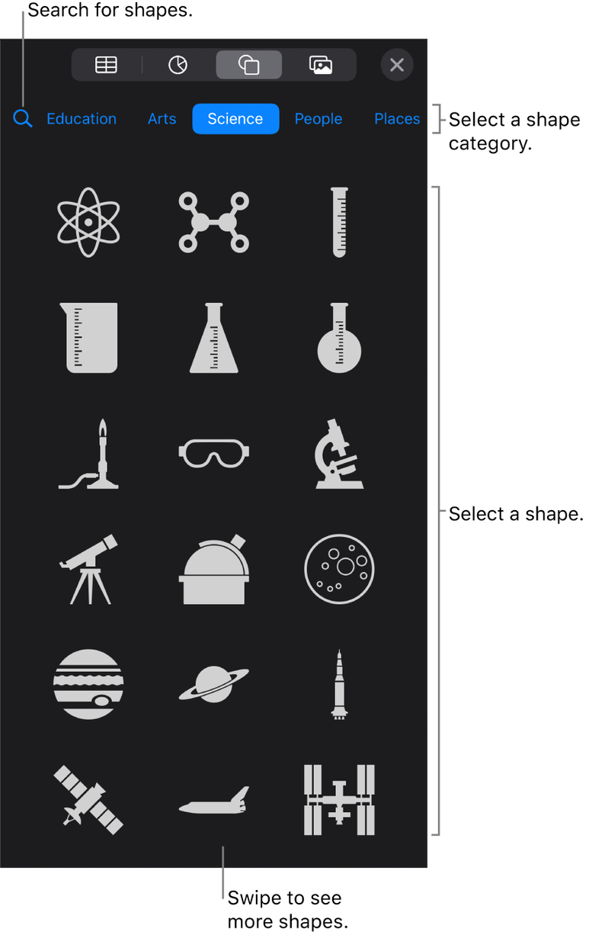
Add your photo to a blank Keynote.
Try adding in some icons.
Could you use animations?

Slide 13

SHARE YOUR WORK
Export your work
Scan the QR code
Upload your work to the Seesaw Journal

Slide 14



Notes:
Quiz link to follow

